Slide 1
Bilateral Skills
This presentation will help staff:
Understand what bilateral skills are
Know how you might notice if someone is having difficulties with bilateral skills
Select activities to support those who are having difficulties

Slide 2
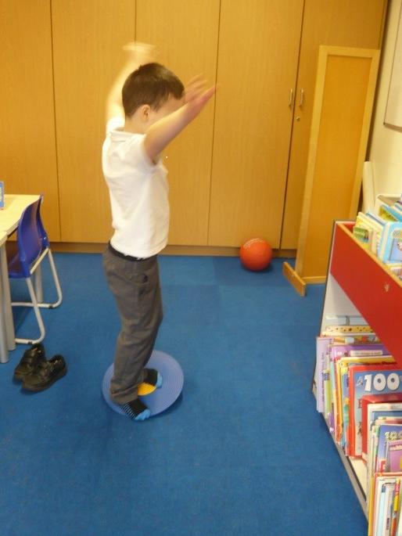
About Bilateral Skills
Bilateral skills are required for most tasks.
This includes the ability to use both sides of the body at the same time or to alternate sides of the body during movement.
Bilateral skills are required to enable establishment of eye, hand and foot dominance.

Slide 3
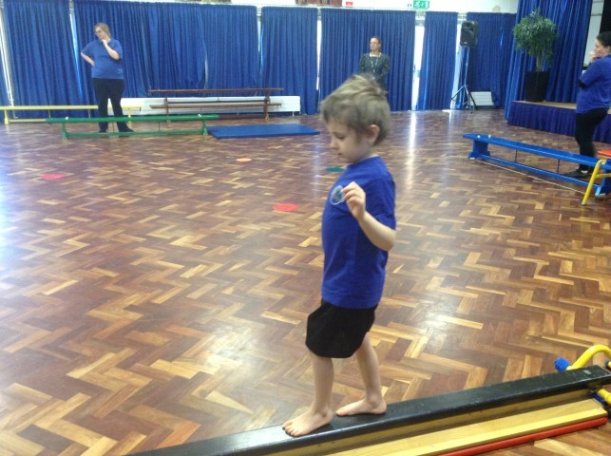
Challenges with Bilateral Skills
Children with challenges in this area often have difficulty:
Catching a ball
Kicking a ball
Handwriting – not stabilising work
Unable to ride a bike
Unable to skip, hop or jump
Difficulty with scissors skills
Dressing difficulty
Difficulty accessing PE

Slide 4
Activities to Support Bilateral Skill Development
Marching on the spot (lower primary)
This requires both sides reciprocally.

Slide 5
Activities to Support Bilateral Skill Development
Cross crawling (upper primary)
This involves reciprocal movement and midline crossing

Slide 6
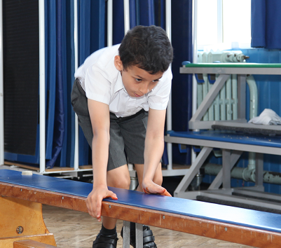
Activities to Support Bilateral Skill Development
Crawling on obstacle courses or similar
This involves reciprocal movement and requires sequencing.

Slide 7
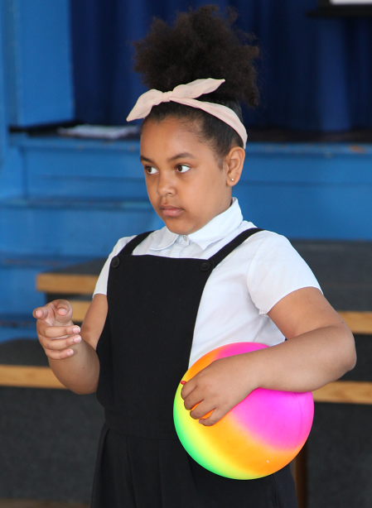
Activities to Support Bilateral Skill Development
Use a balloon or beach ball to develop catching skills before using standard and small balls.
This will make the task easier to start off with and promotes success, therefore increasing the motivation to try.

Slide 8
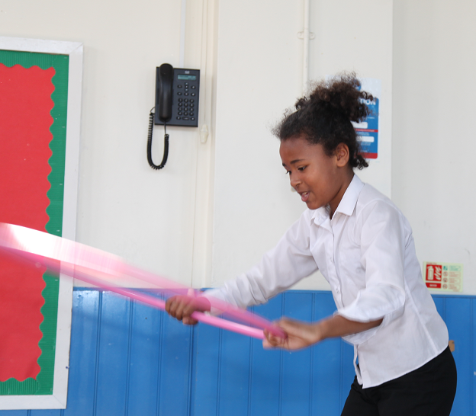
Activities to Support Bilateral Skill Development
Learning to skip using a hula hoop before a skipping rope
using the hula hoop will reduce the complexity of the task.

Slide 9
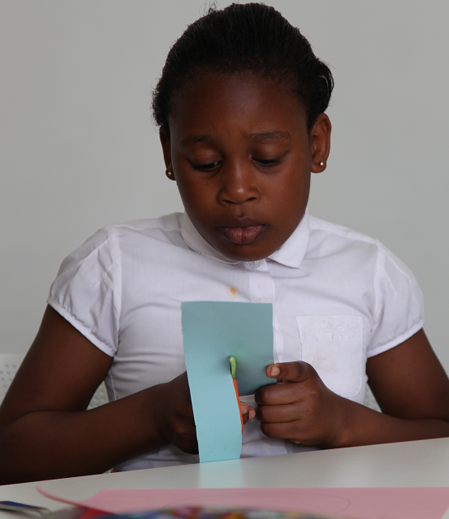
Activities to Support Bilateral Skill Development
Learning to snip with scissors on card before moving on to complex scissor skills
Snipping card will reduce the need to control paper which will bend, making the task harder.

Slide 10
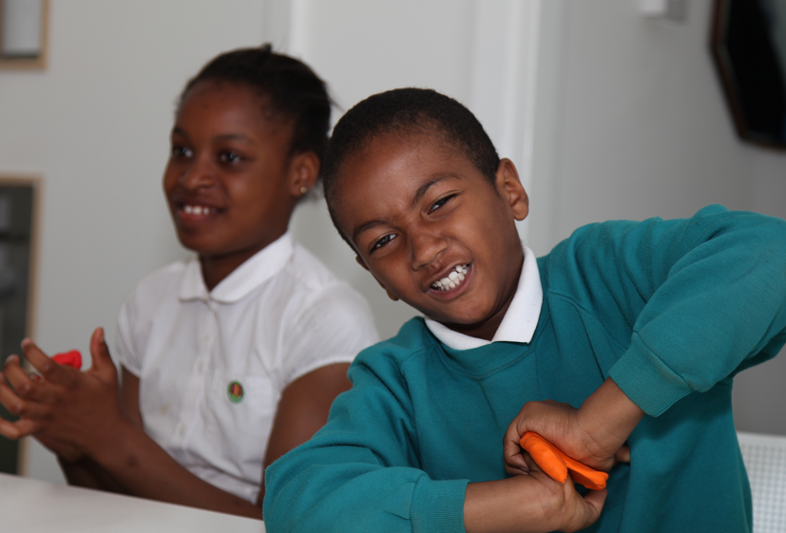
Activities to Support Bilateral Skill Development
Dough activities including rolling, pulling, and pushing
This will promote the use of both hands together.

Slide 11
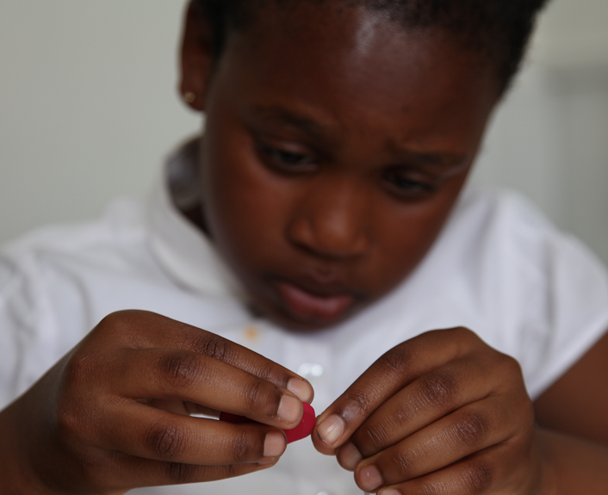
Activities to Support Bilateral Skill Development
Arts and craft activities
This will promote the use of hands together and promote one hand to stabilise while the other does the activity

Slide 12
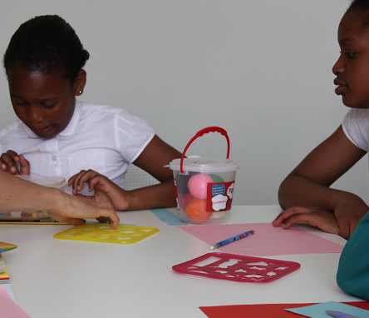
Activities to Support Bilateral Skill Development
Tracing using stencils
This promotes the use of a stabilising hand and a working hand and can support the development of hand dominance.

Slide 13
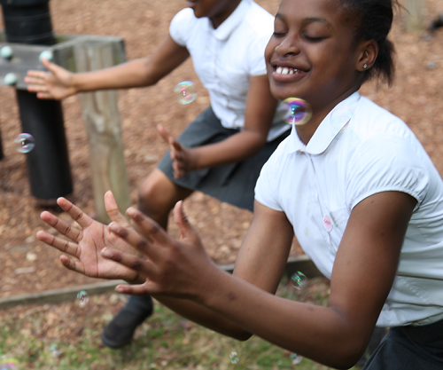
Activities to Support Bilateral Skill Development
Clapping to pop bubbles
This promotes bilateral hand use and hand eye coordination.

Slide 14
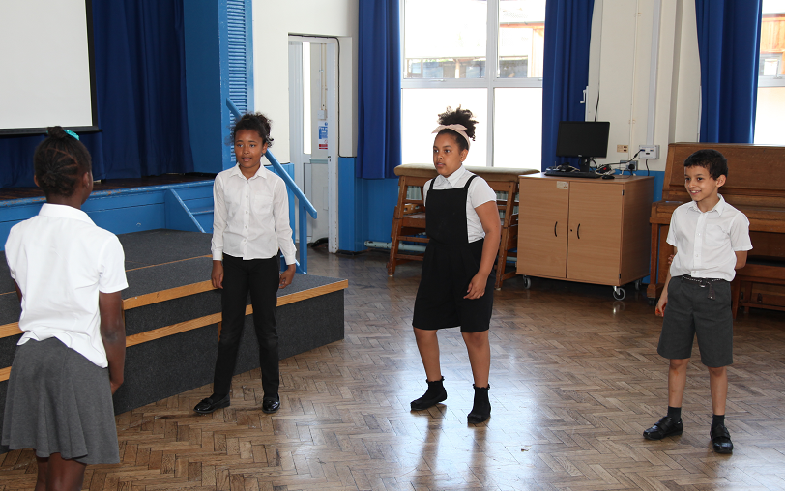
Activities to Support Bilateral Skill Development
Simon Says or similar games requiring movement imitation
This will increase body awareness and support the ability to complete simple movements in different parts of the body.

